Slide 1

Heart Attack Possibility Prediction
Milestone: Project Presentation
Group 18
Student 1: Karan Paresh
Student 2 : Tianyu Yang
857-294-7660 (Tel of Karan Paresh)
617-368-0332 (Tel of Tianyu Yang)
samani.k@northeastern.edu
yang.tianyu@northeastern.edu
Percentage of Effort Contributed by Student 1: 50%
Percentage of Effort Contributed by Student2: 50%
Signature of Student 1: Karan Paresh
Signature of Student 2: Tianyu Yang
Submission Date: 12/3/2021

Slide 2
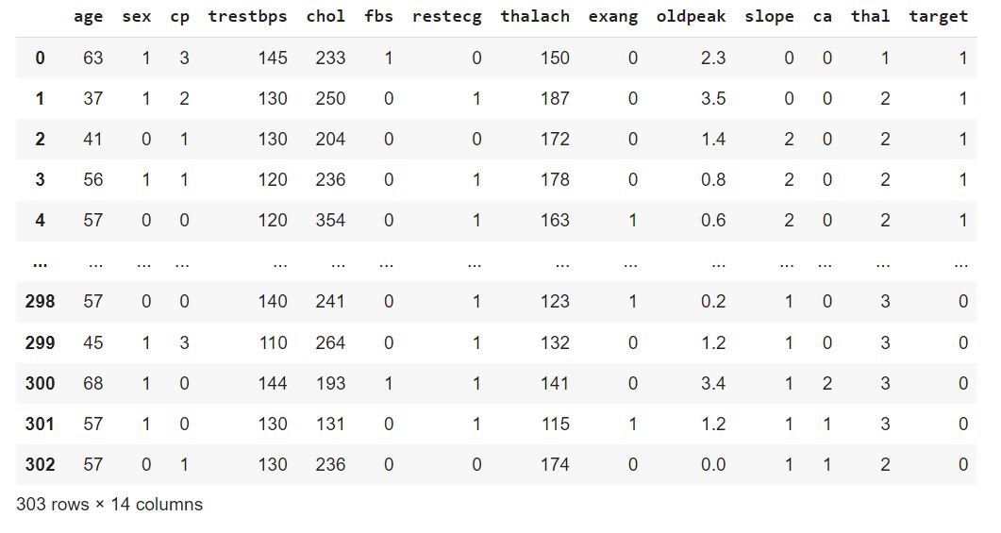
Heart attack possibility prediction -Dataset

Slide 3
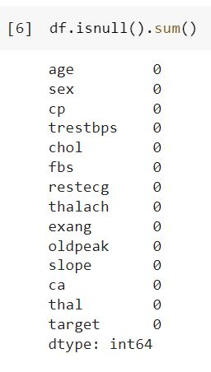
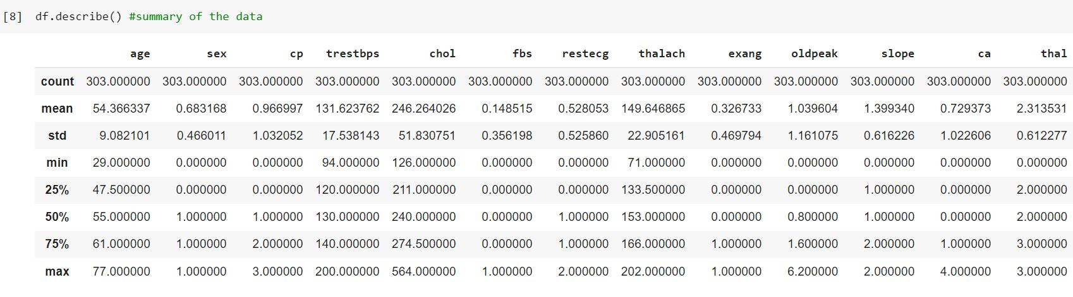
The dataframe has 14 variables and 303 records, the data has both continuous and discrete variables.
Discrete variables = sex, cp (chest pain type), fbs (fasting blood sugar), restecg, exang (exercise induced angina), slope, ca (major vessels colour by flouropsy) , thal, target
Continuous variables = age, trestbps (resting blood pressure), chol (serum cholesterol), thalach, oldpeak (ST depression induced by angina).
The heart attack dataset contains zero null values and the data imputation on the null values aren’t required. The label encoding is also not required for any of the features.

Slide 4
Data Visualization

Slide 5
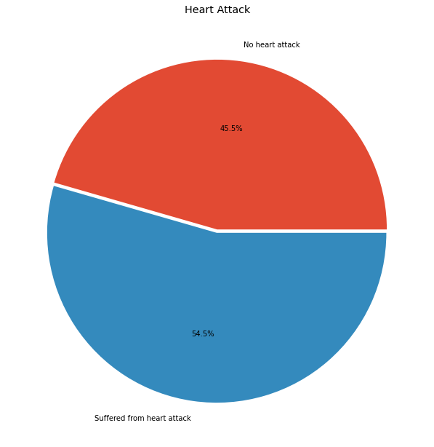
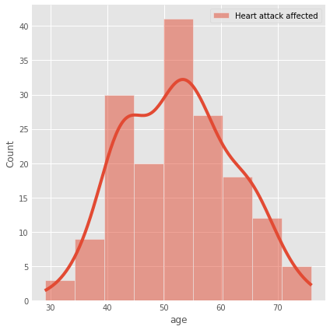
The pie chart represents the percentage of people who may suffer from the heart disease and percentage of those who may not. The result shows that 45.5% people do not suffer from heart attack and 54.5% people suffer from heart attack.

Slide 6
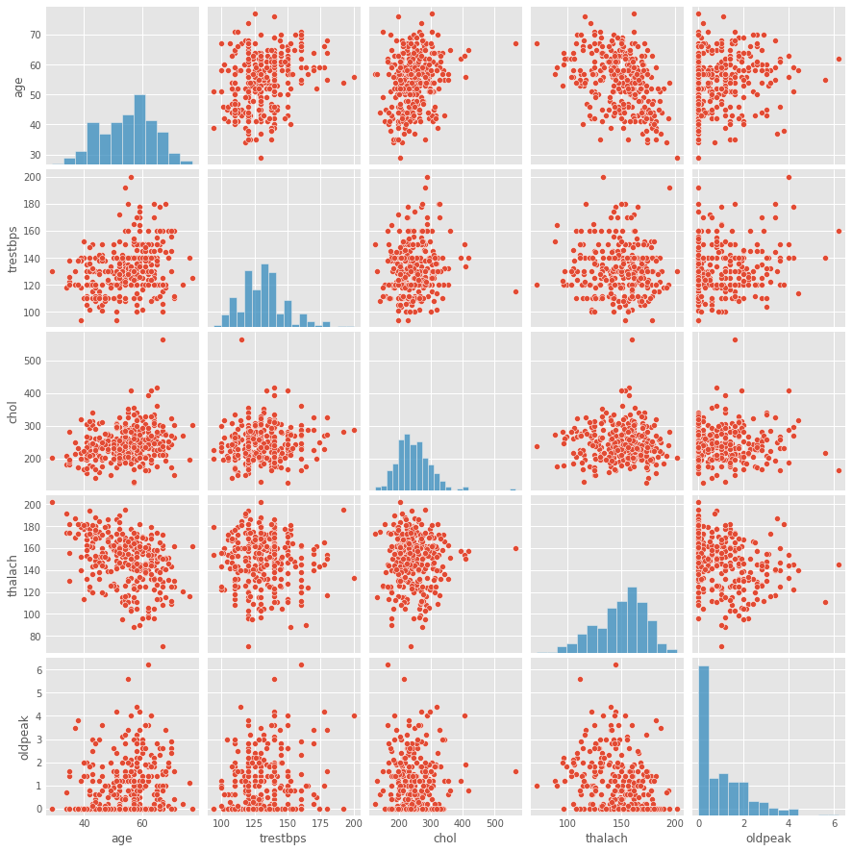
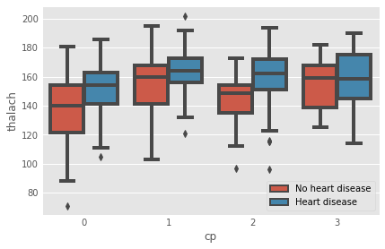
The boxplot shows that the heartrate (thalach) is gradually higher for those who are suffering from the heart disease and on the other hand as the severity of chest pain (cp) increases the mean heartrate is also increasing

Slide 7
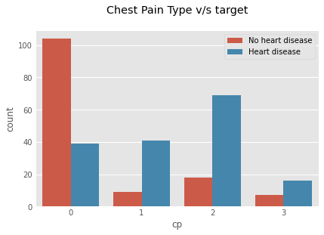
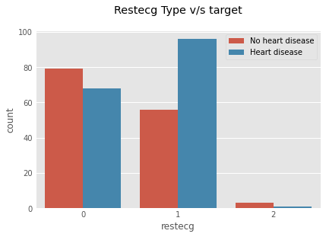
There are four types of chest pain, asymptomatic, atypical angina, nonanginal pain and typical angina. Most of the Heart disease patients are found to have atypical anginal and non anginal chest pain and very few have typical angina. As the severity increases the number of people who are suffering from heart disease are more compared to those who are not suffering from heart disease. These group of people might show symptoms like indigestion, flu or a strained chest muscle.Heart attack, involves, blockage of blood flow to your heart and
possible damage to the heart muscle
There are three types of restecg states Value 0: normal, Value 1: showing probable or definite left ventricular hypertrophy by Estes’ criteria, Value 2: having ST-T wave abnormality (T wave inversions and/or ST elevation or depression of > 0.05 mV).As the severity increases the number of people who are suffering from heart disease are more compared to those who are not suffering from heart disease.The result shows that people who are suffering from the heart disease have higher ecg value and maximum people has 'value' = 1 and very few suffering from heart disease has ‘value’=2.

Slide 8
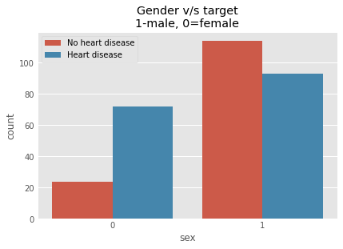
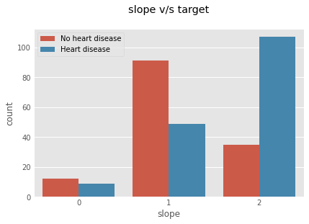
According to this dataset males are more susceptible to get Heart Disease than females. Men experience heart attacks more than women. Sudden Heart Attacks are experienced by men between 70% — 89%. Woman may experience a heart attack with no chest pressure at all, they usually experience nausea or vomiting which are often confused with acid reflux or the flu.
The slope of the peak exercise ST segment has three values 0: down-sloping; 1: flat; 2: upsloping, when the value is 0 and 2 the possibility of heart attack is high and when it is 1 the chances of getting heart attack is less. The graph shows the people who are suffering from the heart disease has the slope value of either 0 or 2 and maximum people who do not suffer from the heart disease has the slope value 1.
Figure 9:

Slide 9
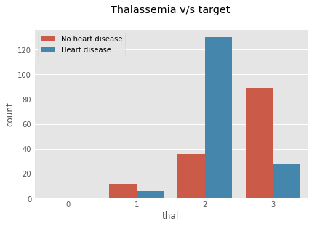
A blood disorder called thalassemia, it has discrete values Value 1: normal blood flow Value 2: fixed defect (no blood flow in some part of the heart) Value 3: reversible defect (a blood flow is observed but it is not normal).The graph shows that people who are suffering from heart disease has a defect value 2 and 3 and those arent suffering from heart disease has a value 1 and 3.

Slide 10
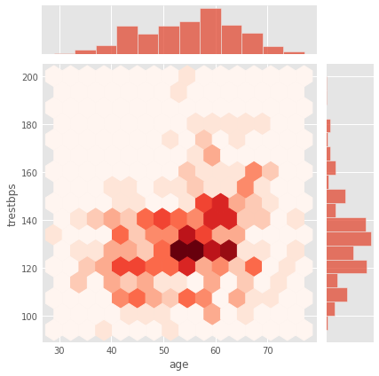
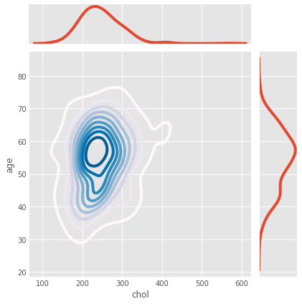
Joint plots in seaborn helps us to understand the trend seen among two features. As observed from the above plot we can see that most of the Heart diseased patients in their age of upper 50s or lower 60s tend to have trestbps higher than 120mmHg
Joint plots in seaborn helps us to understand the trend seen among two features. As observed from the above plot we can see that most of the Heart diseased patients in their age of upper 50s or lower 60s tend to have Cholesterol between 200mg/dl to 300mg/dl.

Slide 11
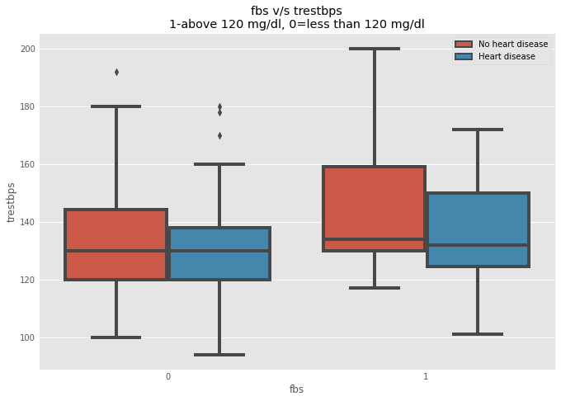
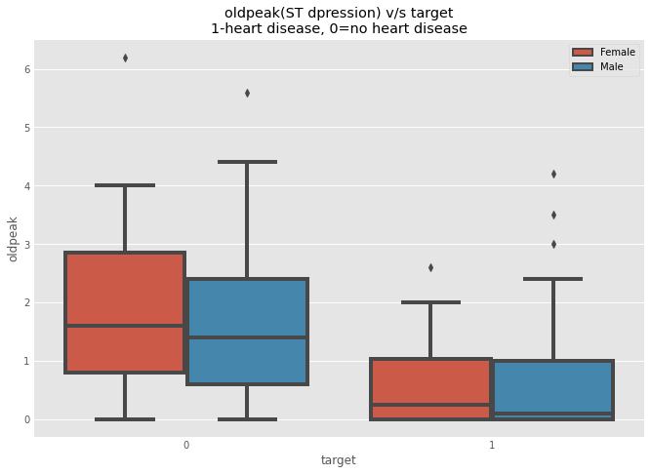
The boxplot shows that the people who are diabetic (fasting blood sugar) has higher resting blood pressure which concludes that these group of people tend to have higher chances of having heart disease.
The boxplot shows that low ST Depression (oldpeak) yields people at greater risk for heart disease. While a high ST depression is considered normal & healthy. If the range is lesser than 1.5 its a high risk and if it is greater than 1.5 the person is at low risk of getting a heart attack.

Slide 12
Feature Selection

Slide 13
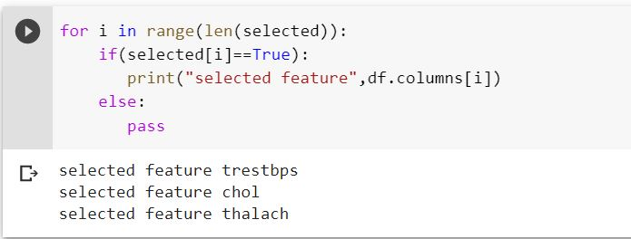
L1 (Lasso) penalty Feature selection
The selected features are : -
1. Trestbps (resting blood pressure)
2. Chol (cholesterol)
3. Thalach (Heart rate)

Slide 14
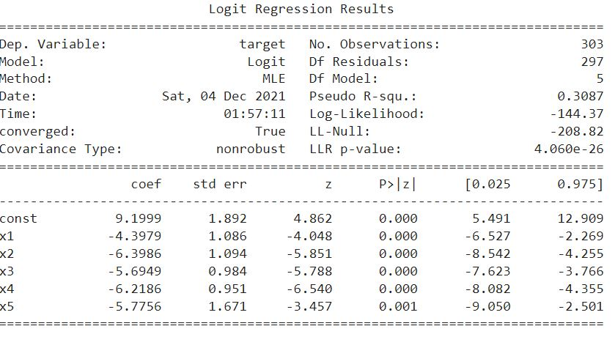
Backward Feature selection
The selected features are : -
1. Sex
2. Exang (Exercise induced angina)
3. Oldpeak (ST depression induced by exercise)
4. Ca (number of major vessels colored by flouropsy)
5.Thal (thalassemia)

Slide 15
Modeling

Slide 16
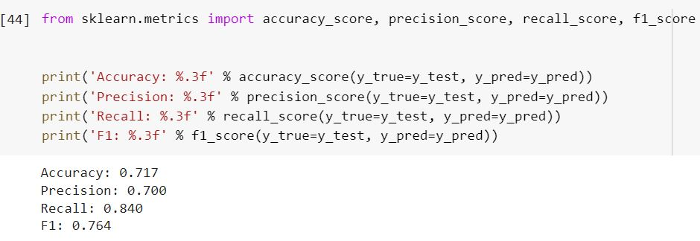
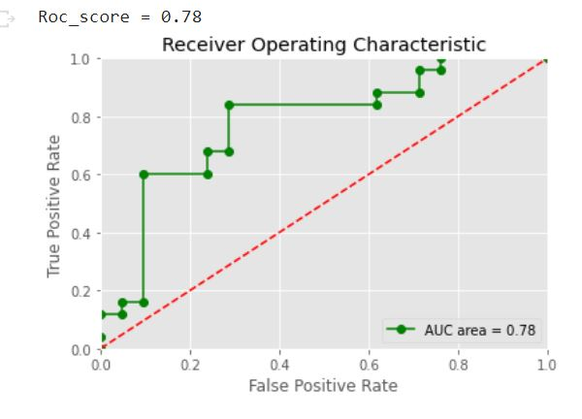
Logistic Regression
1. Accuracy score = 0.71
2. Roc_auc_score = 0.78

Slide 17
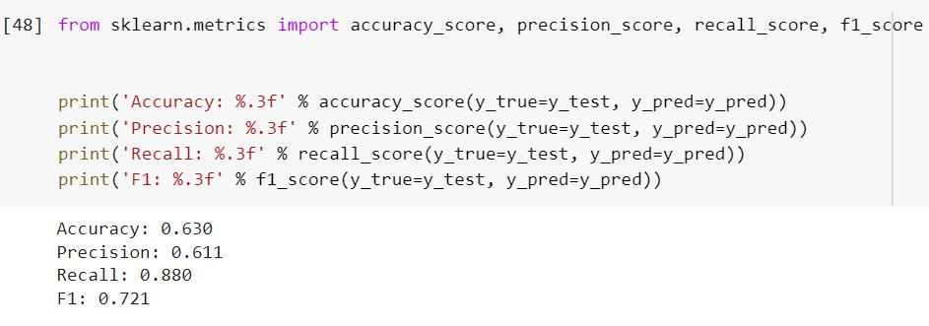
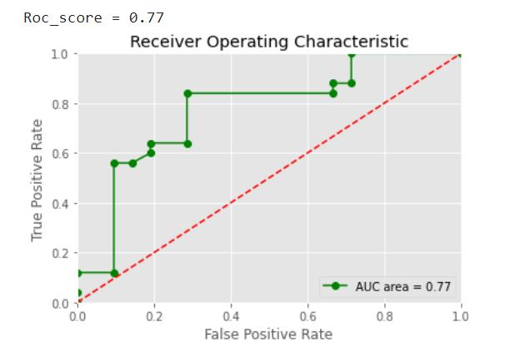
Support vector machine (SVM)
1. Accuracy score = 0.63
2. Roc_auc_score = 0.77

Slide 18
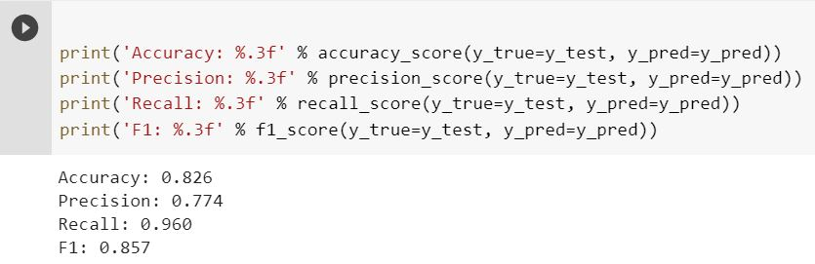
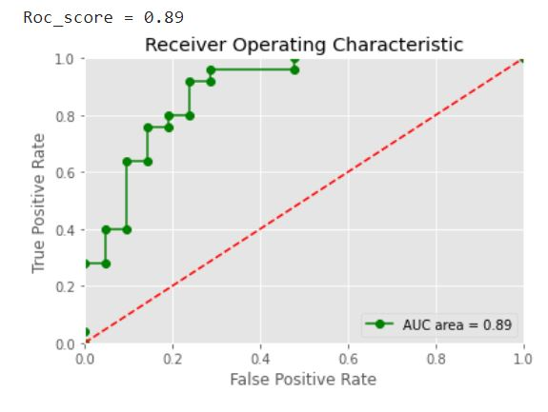
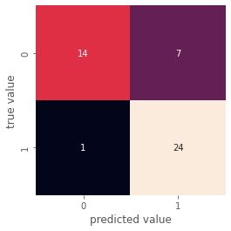
Gaussian Naïve bayes (gnb)
1. Accuracy score = 0.82
2. Roc_auc_score = 0.89

Slide 19
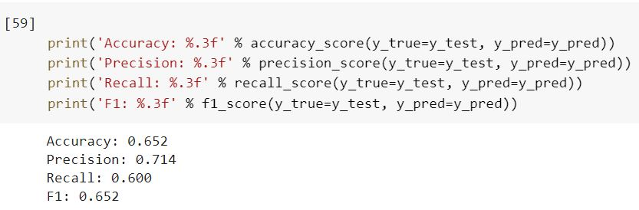
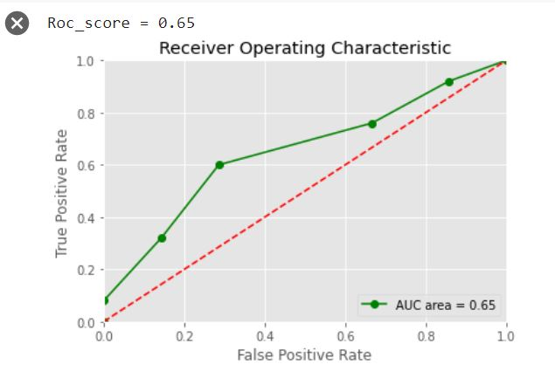
K-nearest neighbors (KNN)
1. Accuracy score = 0.65
2. Roc_auc_score = 0.65

Slide 20
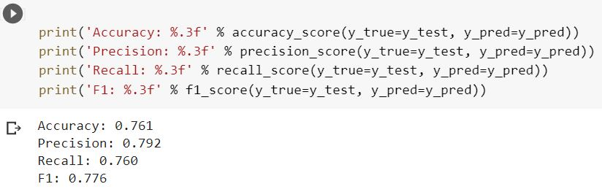
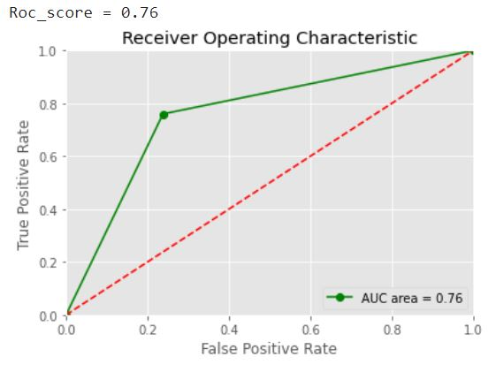
Decission-Tree classifier
1. Accuracy score = 0.76
2. Roc_auc_score = 0.76

Slide 21
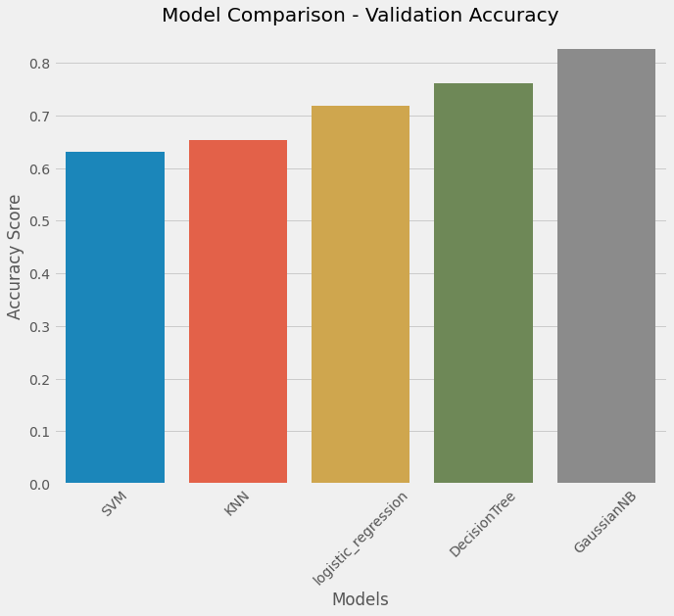
Comparing models using accuracy score
Results:-
The barplot shows the Gaussian Naive bayes model performs the best amongst all the classification models that we used.
The accuracy of the models follows the order as listed:-
1.Gaussian naive bayes (Best model)
2.Decission Tree
3.Logistic Regression
4.K-Nearest-Neighbors
5.Support vector Machine

Slide 22
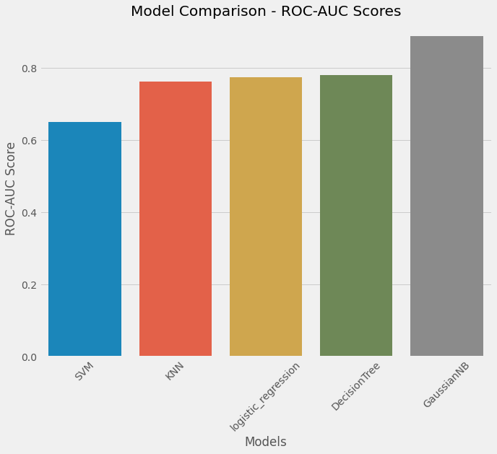
Comparing models using Roc_auc score
Results:-
The barplot shows the Gaussian Naive bayes model performs the best amongst all the classification models that we used.
The Roc_auc score of the models follows the order as listed:-
1.Gaussian naive bayes (Best model)
2.Decission Tree
3.Logistic Regression
4.K-Nearest-Neighbors
5.Support vector Machine

Slide 23
THANK YOU

